Slide 1

VARDHAMAN COLLEGE OF ENGINEERING, HYDERABAD Autonomous institute affiliated to JNTUH DEPARTMENT OF COMPUTER SCIENCE & ENGINEERING
Enhancing Goal Achievement through Collaborative Goal Tracking: A Recommender System Approach
BATCH ID : 20PWCS-D01
 | S. No | Roll. No | Student Name
 | 1 | 20881A05P5 | KOUSAR SHAIK
 | 2 | 20881A05L1 | K MANOJ REDDY
 | 3 | 20881A05J8 | B SAI VARDHAN
PROJECT WORK REVIEW
Guide Details
Dr H Venkateswara Reddy
Professor
Department of CSE

Slide 2
Project Work Review Outlines
Main idea of the Project
Existing System Vs Proposed
Proposed Project Objectives
Proposed Project Outcomes
Software and Hardware Requirements
Process Model
Design Phase
Architectural Diagram [Modified]
[UML Diagrams or Data Flow Diagrams] and ER-Diagrams ; It should be detailed diagrams
Proposed Method s and Algorithms [ With example]
Test Cases
Result Analysis
Output Screens
Conclusion
Future Scope
References

Slide 3
Main idea of the Project
The main idea of the project is to create a goal-tracking and social networking app that allows users to set, monitor, and achieve their personal goals while also facilitating communication and interaction with other users who share similar goals.
This app aims to provide a supportive community for individuals striving to achieve various objectives in their lives.

Slide 4
Existing System Vs Proposed
Existing System:
There are various standalone goal-tracking apps available that focus solely on individual goal management.
Users often tend lack motivation using the existing apps.
Proposed System:
Our proposed app combines goal tracking and social networking features.
Users can not only set and monitor their goals but also connect with others pursuing similar objectives.
This app fosters a sense of community and mutual support among users with common goals.
This app also help users to keep motivated by interacting with others users who share similar goal.

Slide 5
Proposed Project Objectives
Goal Tracking: Develop a user-friendly interface for users to set, track, and manage their personal goals.
Social Networking: Create a social platform where users can search for and connect with others who share similar goals.
Real-time Chat: Implement a chat feature to enable real-time communication between users with common objectives.
Privacy and Security: Ensure the safety and privacy of user data, incorporating secure authentication and data encryption.
User Engagement: Implement features like notifications, progress tracking, and achievements to keep users engaged.

Slide 6
Proposed Project Outcomes
An intuitive and feature-rich goal tracking and social networking app.
A supportive community where users can connect with like-minded individuals.
Improved user motivation and goal achievement rates.
Enhanced user satisfaction and engagement.
A scalable and secure platform for future growth

Slide 7
Software and Hardware Requirements
Hardware Requirement
Laptop or PC
macOS Sierra and above (If Mac setup is required)
Windows 7 or higher
I3 processor system or higher
8 GB RAM or higher
100 GB ROM or higher
Android Phone (6.0 and above)
iPhone (iOS 9 and above)
Software Requirement
Android Studio with Flutter Plugin
XCode (Latest version)
Azure Data Studio

Slide 8
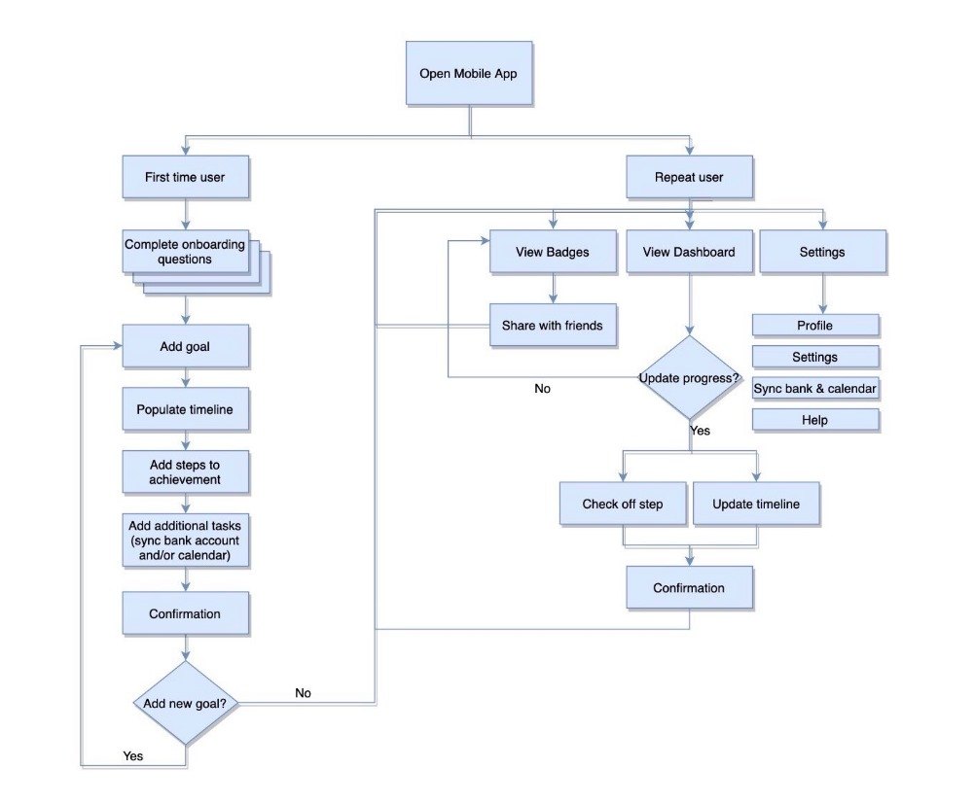
Process Model

Slide 9
Architectural Diagram
User Interface
Flutter framework(Goal screens,etc)
Firebase data base
authentication
Bussiness logic
Goal tracking operationsa
Search and match with similar user
Social networking integration
Api’s
(communication)
Notification system
Logging and analitics

Slide 10
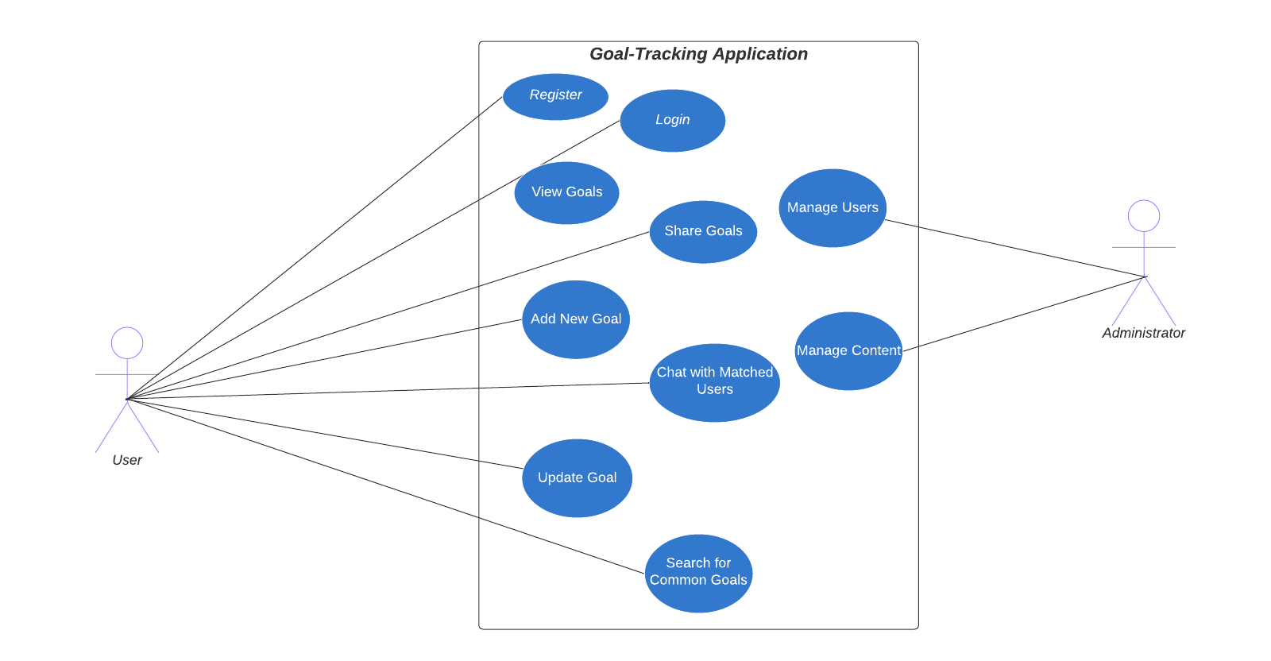
USE CASE DIAGRAM

Slide 11
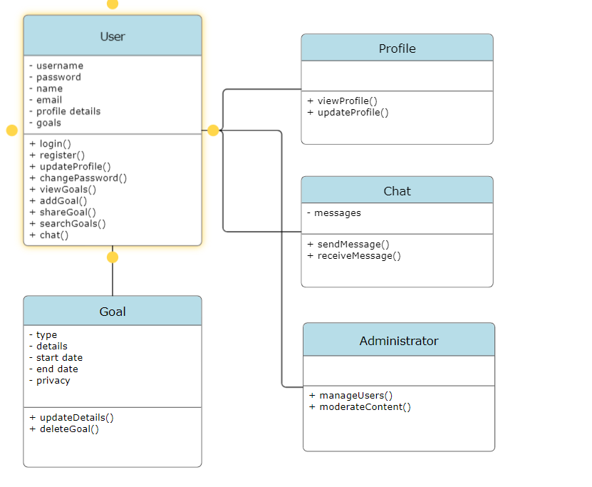
CLASS DIAGRAM

Slide 12
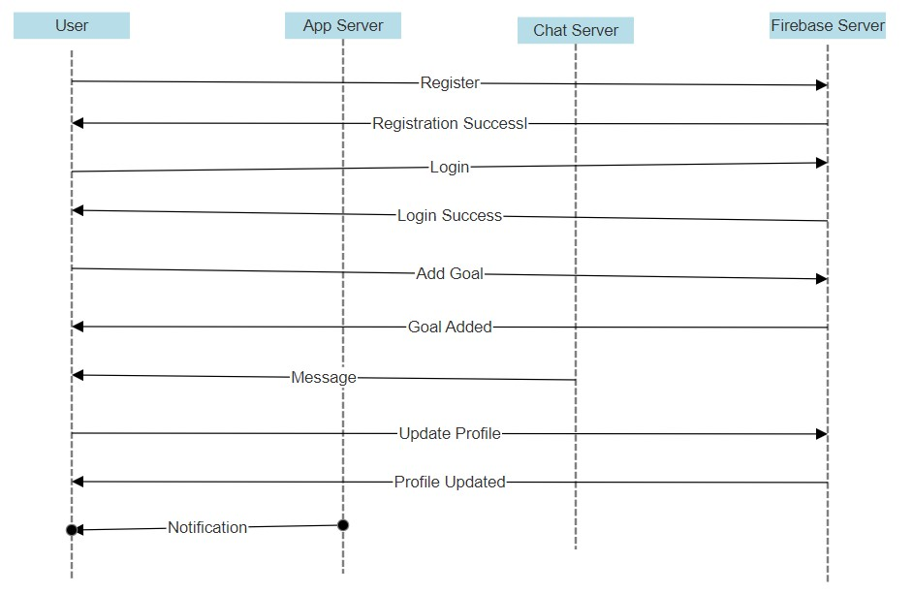
SEQUENCE DIAGRAM

Slide 13
PROPOSED METHOD AND ALGORITHMS
Recommendation logic for users with similar goal.
1. Import necessary packages for Firebase, Flutter, and widgets.
2. Define a screen named SuggestionsScreen.
a. Include a method to create its state.
3. Define a state class, _SuggestionsScreenState.
a. Implement the build method.
i. Use FutureBuilder to asynchronously fetch suggestions.
ii. Display a loading indicator while fetching.
iii. Display an error message if fetching fails.
iv. Display a message if there are no suggestions.
v. Display a list of suggestion cards if suggestions are available.
4. Define a method, fetchSuggestions, to retrieve suggestions from Firestore.
a. Access Firestore instance.
b. Get current user's ID.
c. Fetch suggestions associated with the user.
d. Extract relevant information for each suggestion and create a list of suggestion objects.
e. Return the list of suggestions.
5. Define a class for suggestion cards, SuggestionCard.
a. Include properties like title, body, profile image URL, goal ID, and user ID.
b. Implement a method to build the suggestion card widget.
i. Show user profile image.
ii. Display suggestion title and body.
iii. Allow tapping to navigate to the user's profile.
6. Define a Suggestion class to represent individual suggestions.
a. Include properties like user ID, goal ID, name, profile image URL, and matched words.
b. Implement a constructor to initialize these properties.

Slide 14
PROPOSED METHOD AND ALGORITHMS
One-to-one Chat Logic
1. Import necessary packages for Firebase, Flutter, and widgets.
2. Define a stateful widget named OneToOneChat.
a. Include properties for userId and userData.
b. Implement createState method returning _OneToOneChatState.
3. Define a state class, _OneToOneChatState.
a. Initialize necessary variables and controllers.
b. Implement build method to create the widget UI.
i. Include an app bar displaying user profile.
ii. Show messages in a column with a text field for composing messages.
c. Implement _buildUserProfile method to create the user profile display.
d. Implement _buildMessageComposer method to create the message composer UI.
e. Implement _sendMessage method to send a message.
4. Define a stateless widget named DateHeaderWidget for displaying message date headers.
a. Include a property for the message date.
b. Implement build method to create the date header widget.
5. Define a stateless widget named MessageWidget for displaying individual messages.
a. Include properties for message ID, paths for Firestore, message type, text, and timestamp.
b. Implement build method to create the message widget.
i. Include logic for differentiating between sent and received messages.
ii. Display messages with appropriate styling and timestamp.
iii. Implement long press gesture to show delete confirmation dialog.
iv. Implement methods for handling message deletion.

Slide 15
TEST CASES
User Registration:
Test Case 1: Verify that a new user can successfully register by providing valid details (username, password, email).
Test Case 2: Attempt registration with invalid or incomplete information and ensure appropriate error messages are displayed.
User Interaction:
Test Case 1: Confirm that users can successfully initiate conversations with recommended collaborators.
Test Case 2: Check for proper error handling when a user tries to interact with a non-existent or blocked user.
Goal Addition:
Test Case 1: Confirm that a user can add a new goal with relevant details (type, description, start/end dates, privacy settings).
Test Case 2: Test the application's response when a user tries to add a goal with missing or incorrect information.

Slide 16
RESULTS [Table format comparing Existing and Proposed Method Outputs]
Existing Method Output | Proposed Method Output
Individual goal management. | A sense of community and mutual support among users with common goals.
Users often tend lack motivation. | Help users to keep motivated by interacting with others users.
Standalone Goal Tracking Application. | Goal Tracking Application integrated with social networking feature.
Basic recommendations using simple algorithms. | Advanced recommendation system using collaborative filtering.

Slide 17
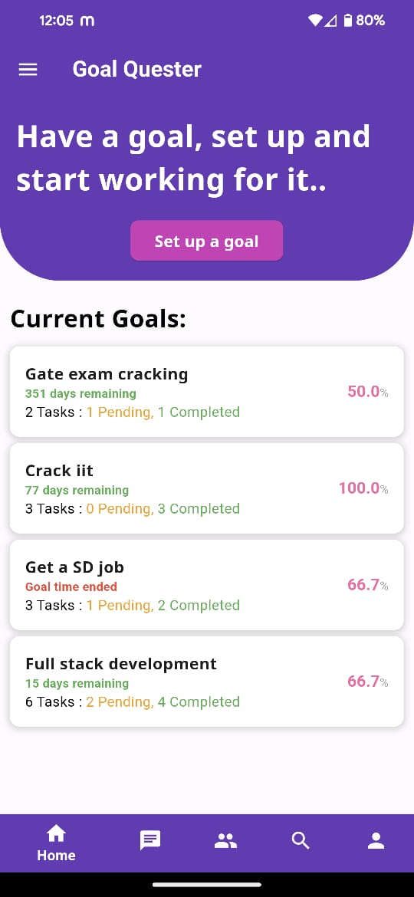
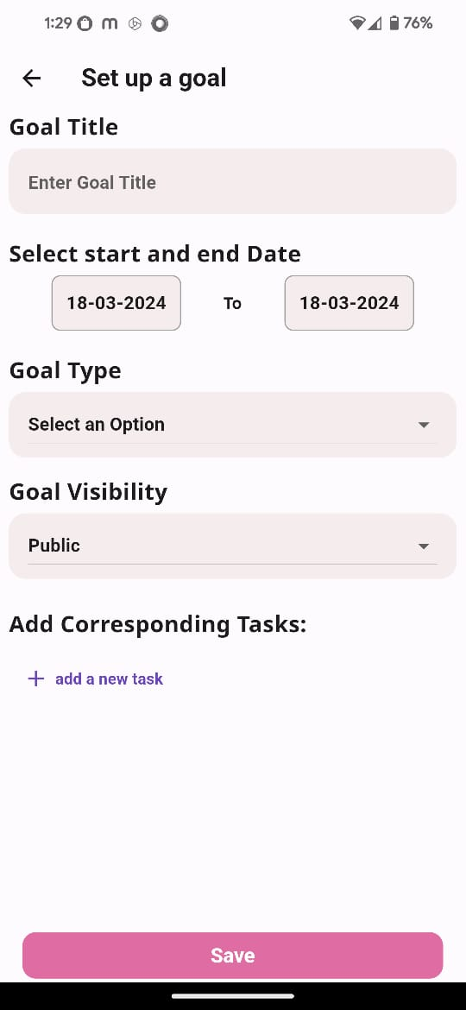
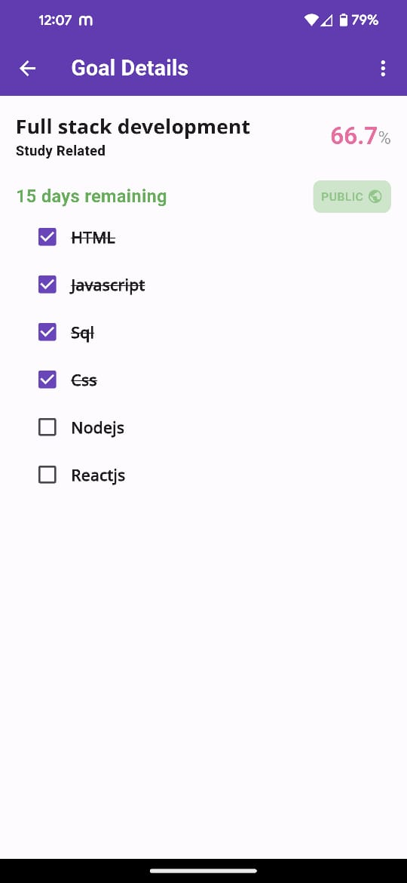
OUTPUT SCREENS

Slide 18
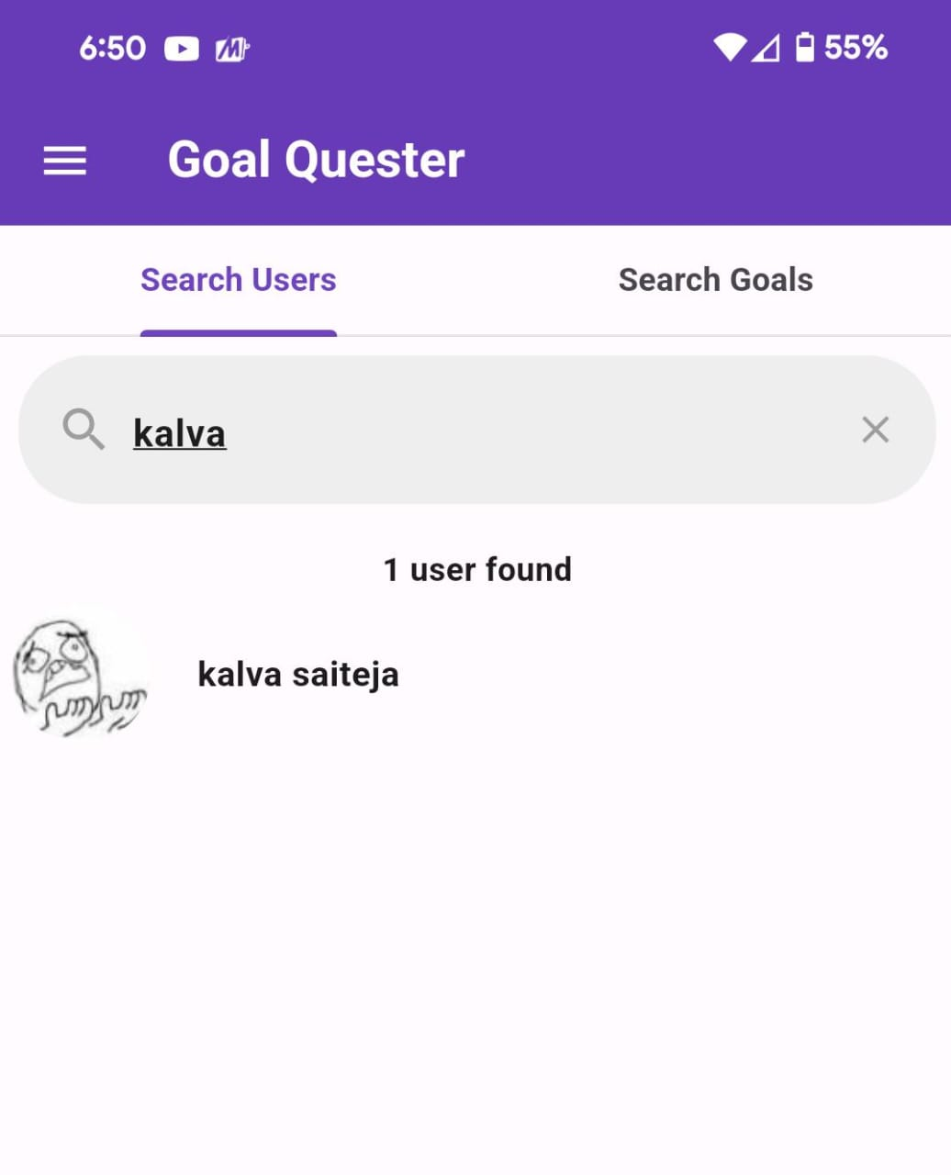
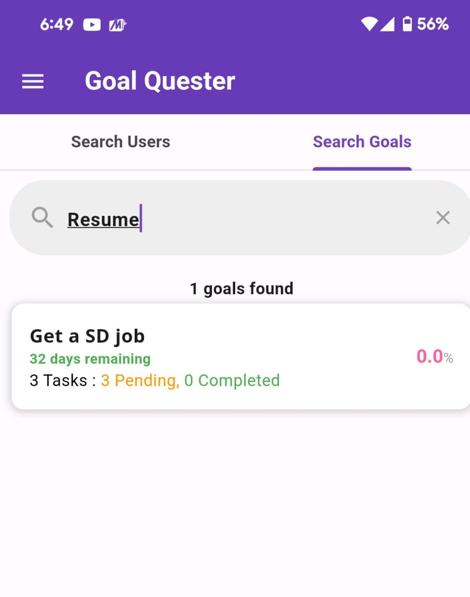
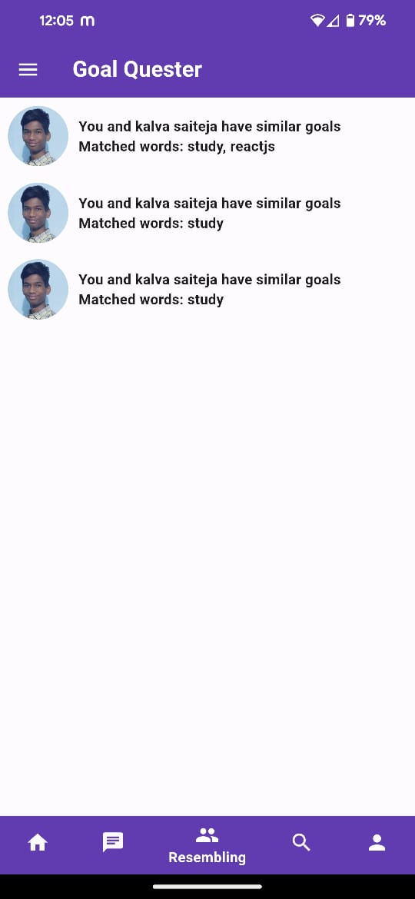
OUTPUT SCREENS

Slide 19
CONCLUSION
The Goal Quester Application is not any other typical goal tracker. While other apps focus on personal achievements, our app is all about bringing people together with similar goals.
We use keywords to represent goals and have smart recommendations to connect users who share common aspirations. This means you not only track your progress but also chat with others, share knowledge, and cheer each other on.
It's like a supportive community working towards goals together, making the journey more enjoyable and motivating.

Slide 20
FUTURE SCOPE
Future work includes refining machine learning algorithms for more accurate goal recommendations, introducing real-time collaboration features, and exploring social media integration for broader community reach.
Developing a dedicated mobile application will enhance accessibility, while wearable device integration promises real-time data for dynamic goal tracking.
Personalizing user experiences through advanced profiling mechanisms and incorporating gamification elements will further enrich the collaborative goal tracking application, ensuring user engagement and support.
Additionally, a focus on accessibility features will promote inclusivity for users with diverse needs.

Slide 21
REFERENCES
[1] Chughtai, Muhammad Waseem, Ali Bin Selamat, and Imran Ghani. "Goal-based hybrid filtering for user-to-user Personalized Recommendation." International Journal of Electrical and Computer Engineering 3.3 (2013): 329.
[2] F.O. Isinkaye, Y.O. Folajimi and B.A. Ojokoh, “Recommendation systems: Principles, methods and evaluation”, Egyptian Informatics Journal, vol.16,pp.261-273, 2015.
[3] L. Soanpet and A. Lakshmi, “Recommendation Systems: Issues and challenges”, IJCSIT,vol.5,pp.5771-5772, 2014.
[4] J. Lu, D. Wu, M. Mao, W. Wang, G. Zhang, “Recommender system application developments: a survey”, Elsevier Decision Support Systems,vol.74, pp.12-32, 2015.
[5] P.B. Thorat, R.M. Goundar and S. Barve, “Survey on collaborative filtering, content-based filtering and hybrid recommendation system”, International Journal of Computer Applications, vol.110, 2015.
[6] Praveena Mathew, Bincy Kuriakose, Vinayak Hegde, Book Recommendation System through content based and collaborative filtering method, 2016 International Conference on Data Mining and Advanced Computing (SAPIENCE).

Slide 22
Thank You

